Slide 1

Evolutionary Computing and Systems

Slide 2

目录
CONTENTS
Introduction and Basic Principles of Evolutionary Computation
01
02
Genetic Algorithm (GA) and Key Techniques
03
Typical Applications of Evolutionary Computation

Slide 3


YOUR LOGO
01
Introduction and Basic Principles of Evolutionary Computation

Slide 4
​​Introduction to Evolutionary Computation
Definition: A stochastic search and optimization method based on natural selection and genetic mechanisms.
Historical Development:
1950s: Emergence of genetic algorithm concepts (Holland)
1970s–1990s: Development of evolution strategies (Rechenberg), genetic programming, and other evolutionary algorithms
2000s–Present: Multi-objective optimization, hybrid intelligence, integration with deep learning

Slide 5

​​Core Concept: Survival of the Fittest
01
Population-based search
Evolutionary algorithms operate on a group of candidate solutions (population) instead of a single one.
This allows the algorithm to explore multiple regions of the search space simultaneously, increasing the chance of finding a global optimum.
02
Fitness evaluation determines "quality"
Each individual (solution) is evaluated by a fitness function, which measures how good the solution is.
Higher fitness means a better solution, and these individuals are more likely to be selected for reproduction.
Utilizes randomness for exploration with directional guidance
03
Evolutionary algorithms use random variation (like crossover and mutation) to explore the search space.
However, they also select better individuals, guiding the search in a promising direction over generations.

Slide 6
​​General Workflow Framework
Initialize Population
The basic steps of an evolutionary algorithm are:
Initialize Population: Randomly create a set of candidate solutions.
Evaluate Fitness: Measure how good each individual is.
Selection: Choose the better individuals for reproduction.
Crossover: Combine parents to generate offspring.
Mutation: Introduce small random changes to maintain diversity.
Update Population: Form a new generation of individuals.
Termination Check: Stop when a condition is met (e.g., max generations or satisfactory solution).
Evaluate Fitness
Selection
Crossover
Mutation
New Population
Termination Condition

Slide 7
​​Brief Overview of Common Evolutionary Algorithm
Genetic Algorithm (GA)
Inspired by biological evolution; uses crossover and mutation to evolve solutions.
Evolution Strategy (ES)
Focuses on mutation-based optimization for continuous problems; good for engineering design
Genetic Programming (GP)
Each individual is a computer program (e.g., expression tree); evolves programs automatically.
Differential Evolution (DE)
Uses vector differences between individuals to guide mutation; effective for numerical optimization.
Particle Swarm Optimization (PSO)
Mimics the behavior of swarms (birds, fish); particles move based on personal and group experience.

Slide 8

Advantages and Limitations of Evolutionary Computation
Advantages:
Limitations:
Strong global search capability, no need for gradient information, suitable for discrete/continuous problems
High computational cost, parameter sensitivity, slower convergence than gradient-based methods

Slide 9
YOUR LOGO
02
Genetic Algorithm (GA) and Key Techniques

Slide 10
​​Chromosome Encoding
Why do you need coding?
In evolutionary algorithms, each candidate solution needs to be "encoded" as a chromosome, so that the algorithm can perform operations such as crossover and mutation.
A chromosome is an abstract representation, essentially a data structure (such as a list, string, tree, etc.) that is used to express a solution to a problem.
The problem of finding the minimum value of a function → Encoding a variable with a list of real numbers
Find the Traveling Salesman Route→ Use the permutation to encode the route order
Here are two examples:

Slide 11
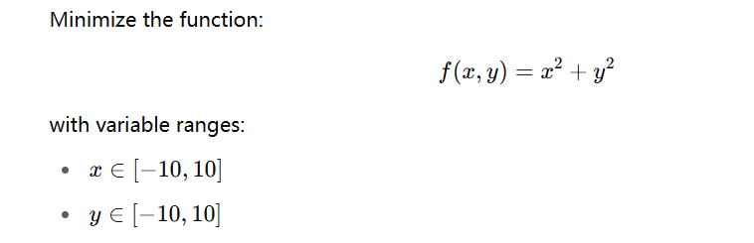

​​Chromosome Encoding
Example 1: Function Minimum Problem → Encoded in real numbers
🎯 Problem Description:
Chromosome Representation (Real-Value Encoding):
Each individual (solution) is represented by a real-valued vector [x,y]

Slide 12
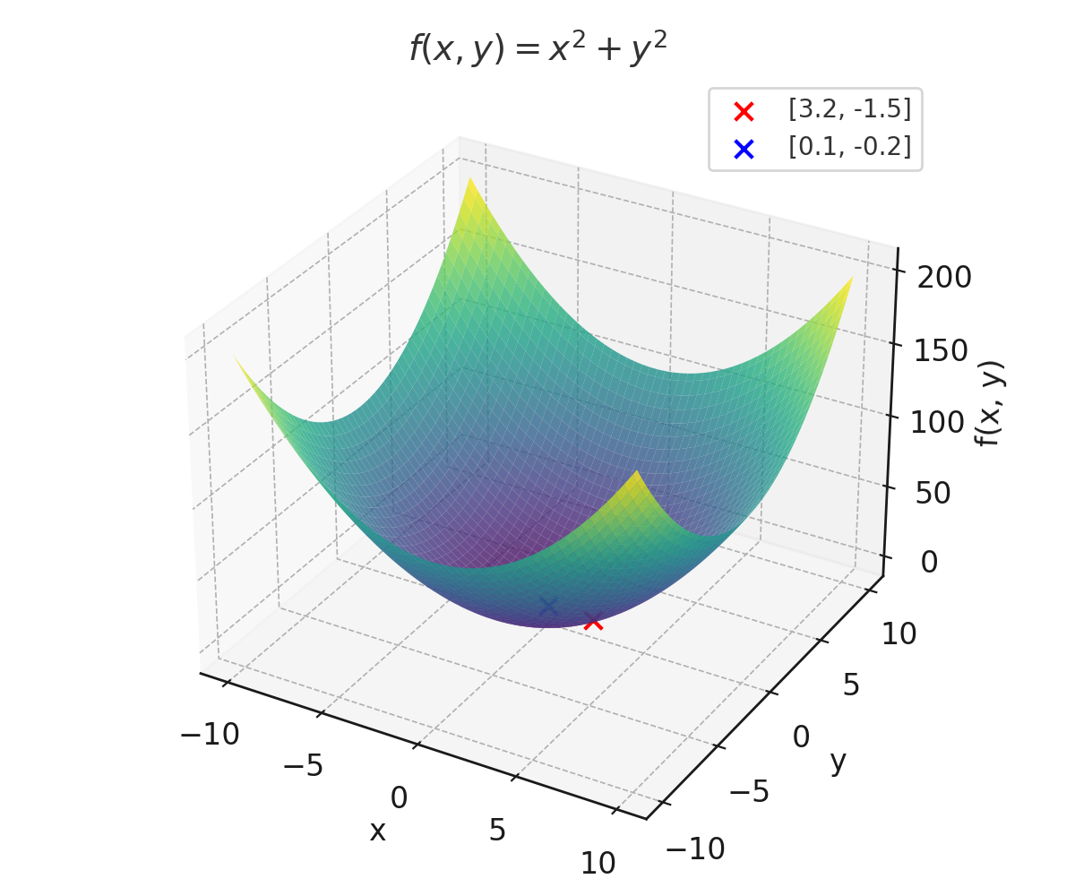
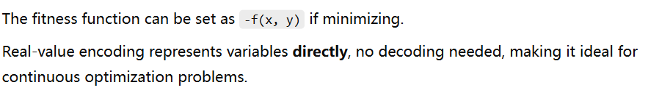
​​Chromosome Encoding
Example 1: Function Minimum Problem → Encoded in real numbers
🎯 Problem Description:
✅ Explanation:

Slide 13
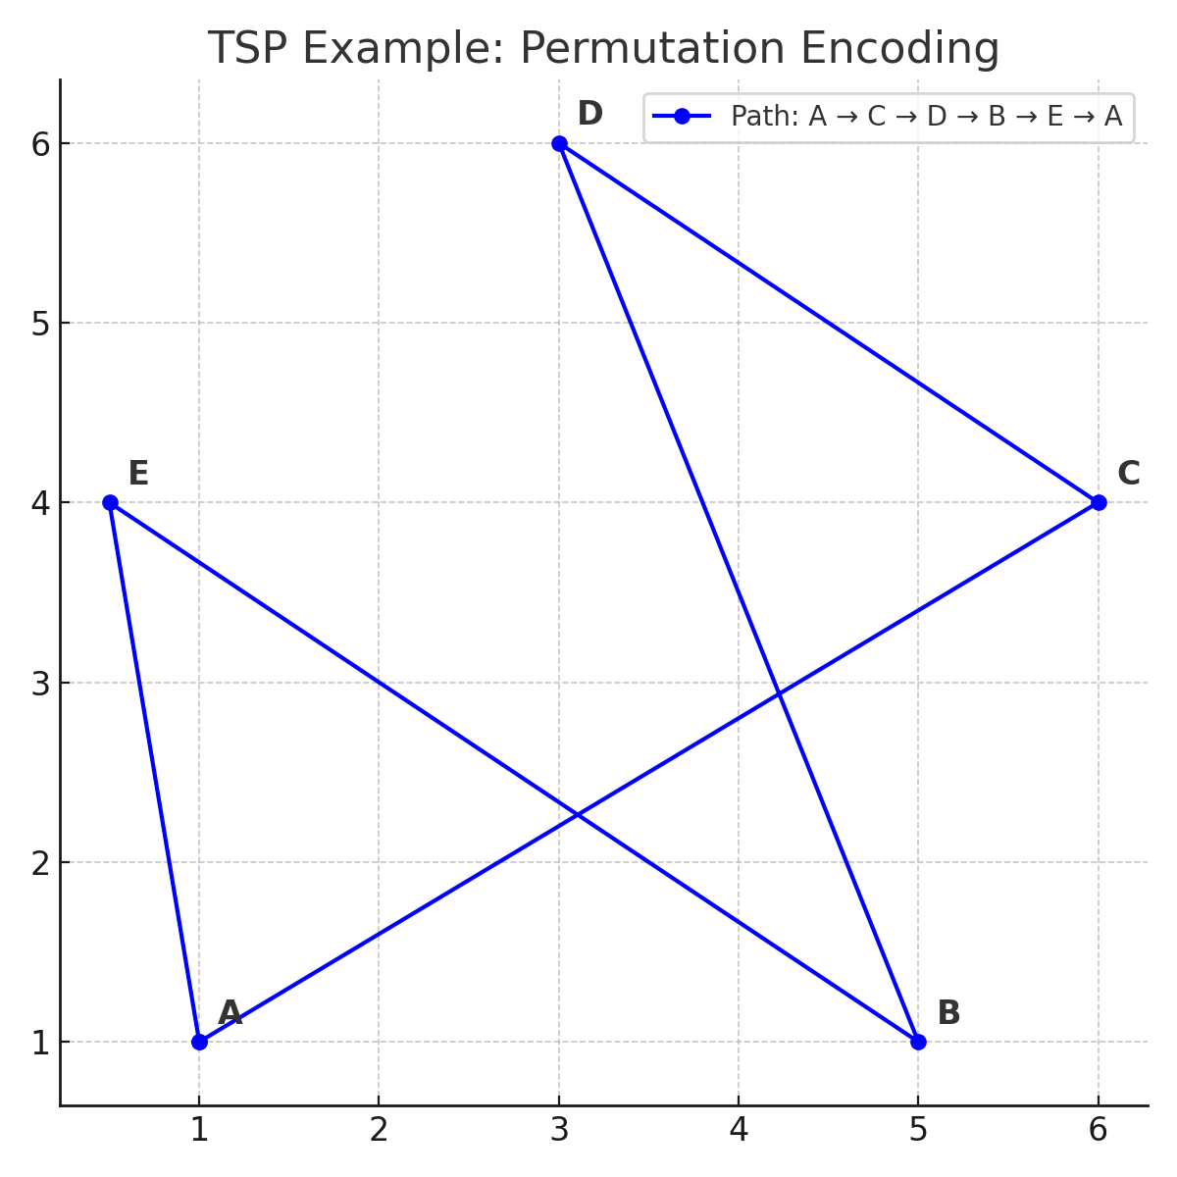

​​Chromosome Encoding
Example 2: Traveling Salesman Problem (TSP) → Permutation Encoding
🎯 Problem Description:
Given 5 cities labeled A, B, C, D, E, find the shortest route that visits all cities exactly once and returns to the starting point.
Chromosome Representation (Permutation Encoding):
Each chromosome is a unique permutation of city labels:

Slide 14
​​Chromosome Encoding
Example 2: Traveling Salesman Problem (TSP) → Permutation Encoding
🎯 Problem Description:
Given 5 cities labeled A, B, C, D, E, find the shortest route that visits all cities exactly once and returns to the starting point.
✅ Explanation:
The route must include each city exactly once → valid permutations only
Total distance is calculated based on city-to-city distances, used as the fitness function (shorter is better).

Slide 15
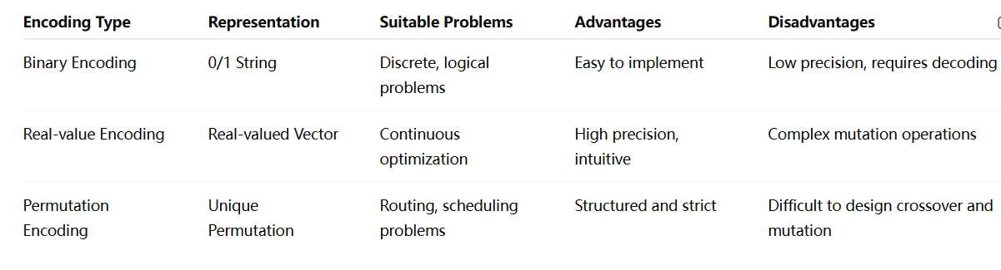
​​Chromosome Encoding
Comparison of different encoding methods

Slide 16
​​Fitness Function Design
The fitness function is the core of the evolutionary algorithm
In evolutionary algorithms, the algorithm doesn't know which solution is "good" unless we evaluate it.
The fitness function assigns a score to each individual (solution) to represent how well it performs in the given problem.
📌 In short: Fitness function = performance measure
Example: For a minimization problem, a smaller function value = better solution.

Slide 17
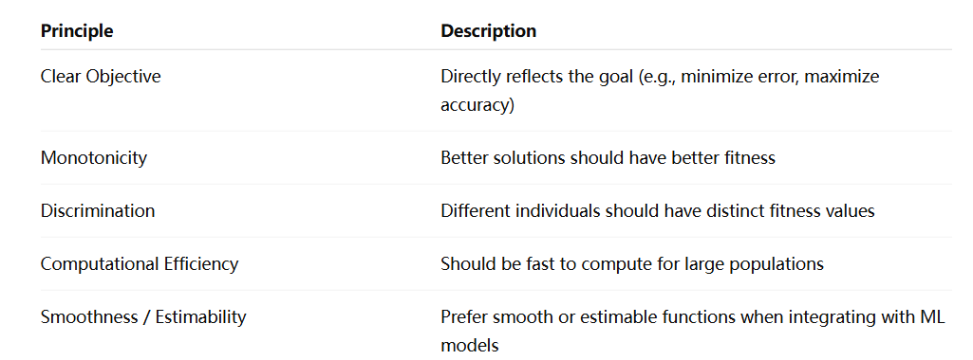
​​Fitness Function Design
Principles of Designing a Good Fitness Function

Slide 18
​​Fitness Function Design
Principles of Designing a Good Fitness Function

Slide 19
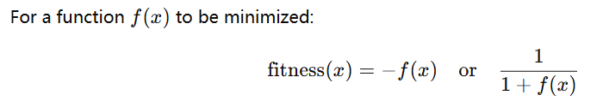
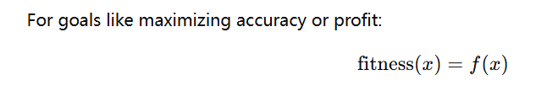
​​Fitness Function Design
How to Design Fitness Functions for Different Problem Types
✅ a) Minimization Problems
⚠️ Avoid divide-by-zero or negative fitness.
✅ b) Maximization Problems

Slide 20
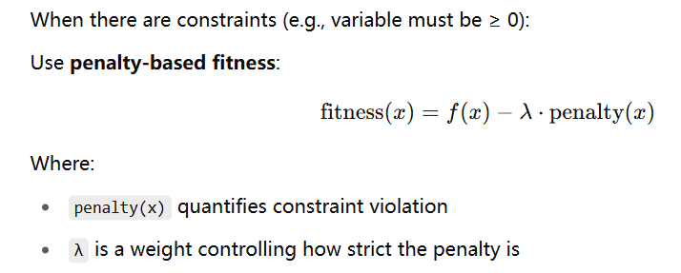
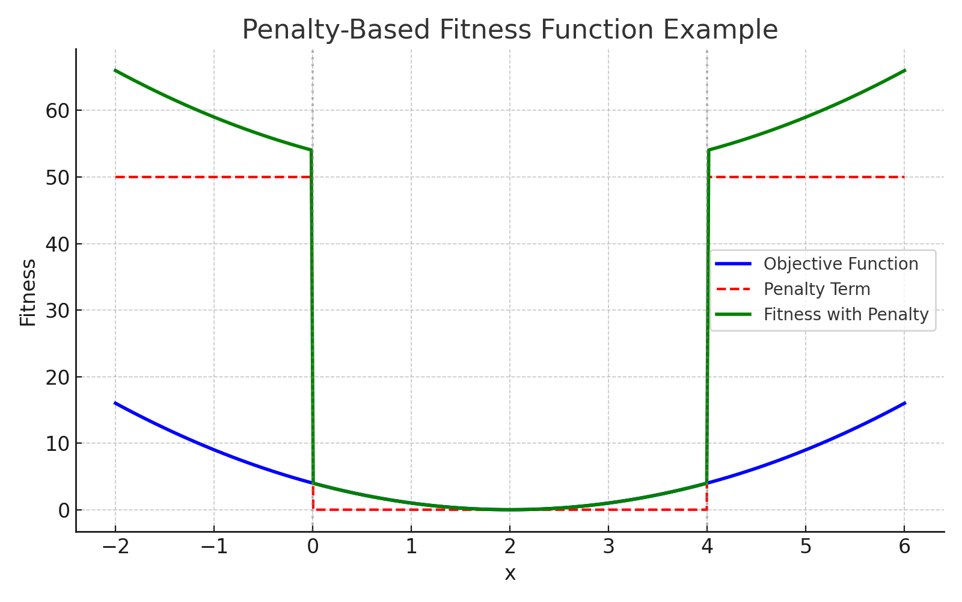
​​Fitness Function Design
How to Design Fitness Functions for Different Problem Types
✅ c) Constrained Optimization

Slide 21
​​Selection Operators​​
In genetic algorithms, how do high-quality individuals pass their genes to the next generation? How do we prevent the loss of superior genes due to random selection?”
Core Principle: Probabilistic Selection​
​​Higher fitness → Higher probability of selection​​ (not absolute).
​​Avoid the “elitism trap”​​: Selecting only the best individuals reduces population diversity (balance ​​exploration vs. exploitation​​).

Slide 22
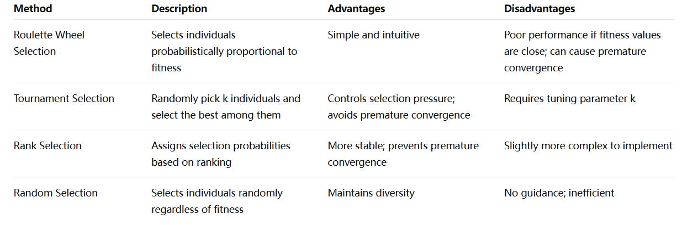
​​Selection Operators​​
Common Selection Methods and Their Principles

Slide 23
​​Crossover Operators​​
Biological Analogy:
Use the analogy of "genetic recombination". Just as the genomes of two parents synthesize a new child, the crossover operation is to combine the two "parent solutions" to generate a new "child solution".
Definitions explained:
In genetic algorithms, crossover operators are used to exchange or recombine the encoded information of two individuals to explore new solution spatial regions and increase population diversity.

Slide 24
​​explanation of ​​crossover operators in genetic algorithms
🔀 ​​1. Single-Point Crossover
Principle: A random cut point is selected on the chromosome and the gene fragment after the two parents of the gene fragment after the point is exchanged.
Process​​:
Randomly select one cut point k (where 1 ≤ k ≤ chromosome_length - 1).
Swap segments after k between two parents:
Parent A: [A₁→Aₖ | Aₖ₊₁→Aₙ] → Child C1: [A₁→Aₖ | Bₖ₊₁→Bₙ]
Parent B: [B₁→Bₖ | Bₖ₊₁→Bₙ] → Child C2: [B₁→Bₖ | Aₖ₊₁→Aₙ]
Example​​:
Parent A: [1 0 0 | 1 1 1], Parent B: [0 0 1 | 1 0 0]
Child C1: [1 0 0 1 0 0], Child C2: [0 0 1 1 1 1]

Slide 25
​​explanation of ​​crossover operators in genetic algorithms
🔀 ​​2. Multi-Point Crossover
Principle: Multiple intersections are selected to alternately exchange gene fragments.
Process​​:
Randomly select m cut points (e.g., two points k1, k2).
Alternately swap segments between parents:
Child C1 inherits Parent A’s odd segments and Parent B’s even segments.
Example​​:
Parent A: [1 | 0 0 | 1 1 1], Parent B: [0 | 0 1 | 1 0 0]
Child C1: [1 | 0 1 | 1 0 0].

Slide 26
​​explanation of ​​crossover operators in genetic algorithms
🔀 ​​3. Uniform Crossover​
Principle: Each locus independently selects the parent source with probability p.
Process​​:
For each gene position i, generate a random number r ∈ [0, 1].
If r ≤ p (typically p=0.5), Child C1 inherits Parent B’s gene; otherwise, Parent A’s.
Example​​:
Parent A: [1 0 0 1], Parent B: [0 1 1 0] → Child C1: [0 0 1 1] (random outcome).
​​Use Case​​: High-diversity needs (e.g., neural network weight optimization)

Slide 27
​​explanation of ​​crossover operators in genetic algorithms
🔀 ​​4. Partially Matched Crossover (PMX)​
Principle: Resolve arrangement conflicts through mapping relationships, which is dedicated to TSP problems..
Process​​:
Select a contiguous gene segment (e.g., [C, D, E]) and swap between parents.
Map conflicting genes (e.g., C↔D, D↔C).
Resolve duplicates using mapping rules.
Example​​:
Parent A: A-B-[C-D-E]-F → Temp Child: A-B-[D-C-B]-F → Resolved: A-B-D-C-F.
​​Use Case​​: Permutation-based problems (e.g., TSP, job scheduling)

Slide 28
​​explanation of ​​crossover operators in genetic algorithms
🔀 ​​5. Order Crossover (OX)​
Principle: Preserve the order of the parent fragments and fill the remaining bits in the order of the other parent.
Process​​:
Copy a segment from Parent A (e.g., [C, D, E]) to Child C1.
Fill remaining positions using Parent B’s gene order (skipping duplicates).
Example​​:
Parent A: A-B-[C-D-E]-F, Parent B: D-C-B-A-F-E → Child C1: B-A-C-D-E-F.

Slide 29
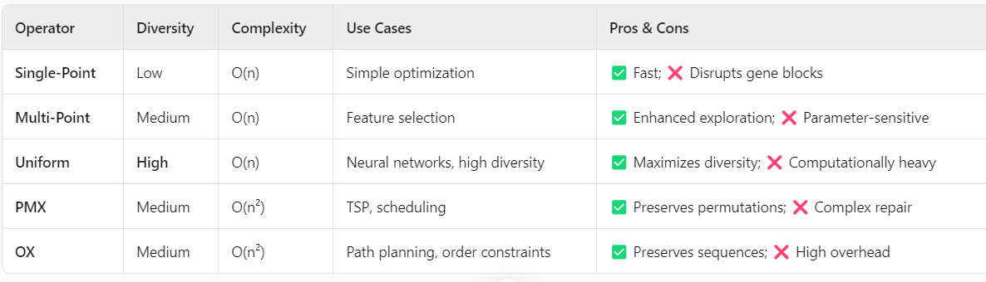
​​Comparative Analysis​

Slide 30
​​mutation Operators​​
Biological Analogy:
Just like genetic mutation in nature, which randomly alters genes and sometimes leads to evolutionary breakthroughs, mutation in algorithms introduces random changes to individuals.
Definition:
A mutation operator applies small random changes to an individual's encoding, introducing new genetic material into the population and preventing premature convergence.

Slide 31
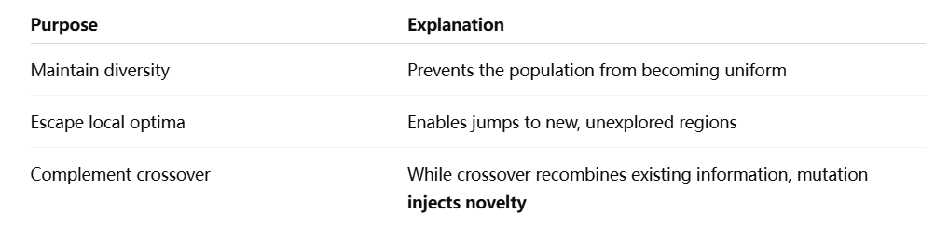
​​mutation Operators​​
Why Is Mutation Necessary?
Key quote:Crossover recombines the past, mutation explores the future.

Slide 32
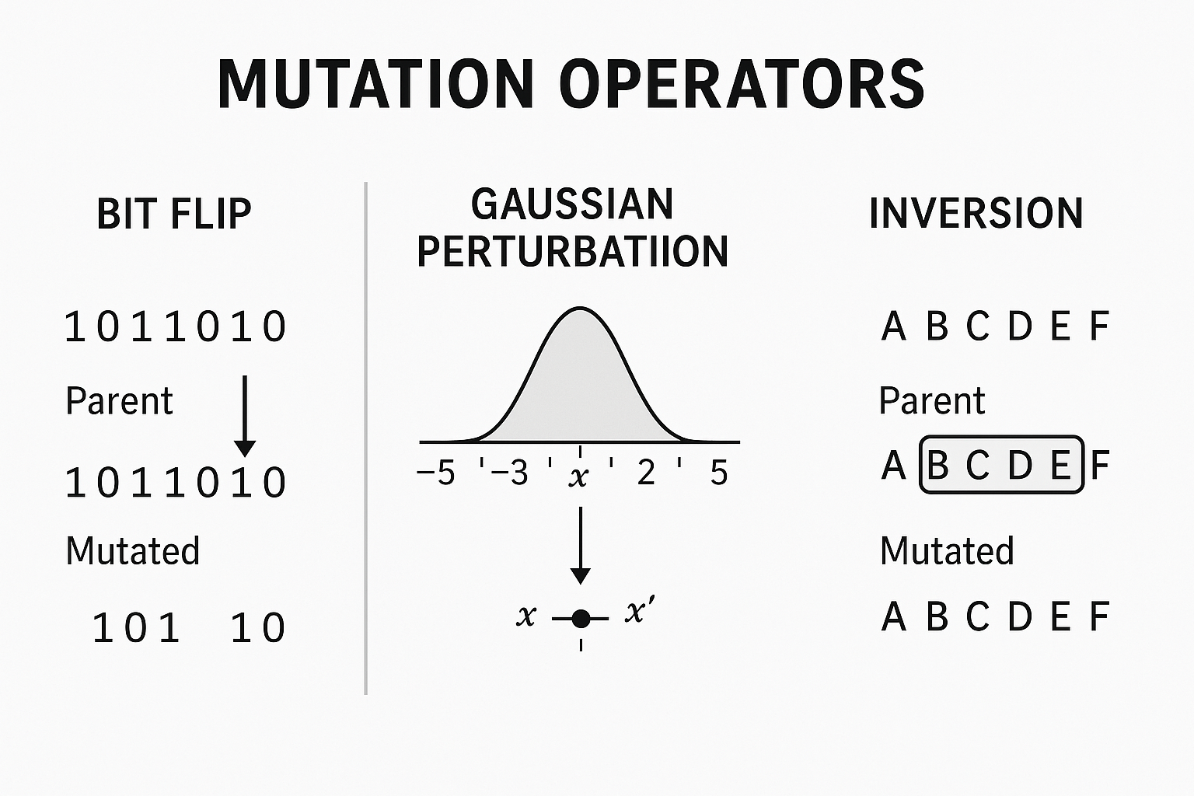

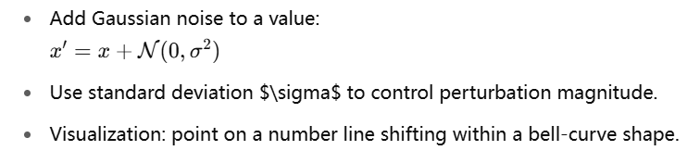
​​Types of Mutation Operators
🔀 1. ​​Bit Flip Mutation
Principle: Flip a bit from 0 → 1 or 1 → 0 with a small probability (e.g., 0.01).
Example​​:
🔀 2.Gaussian Mutation

Slide 33
​​Types of Mutation Operators
🔀 3.Inversion Mutation
Principle: Select a segment of the chromosome and reverse its order.
Example​​:
Summary Quote:
Mutation is the exploratory force in evolutionary computation. Though rare, it can trigger critical breakthroughs. A well-designed mutation strategy is the key to escaping comfort zones and reaching optimal solutions.

Slide 34
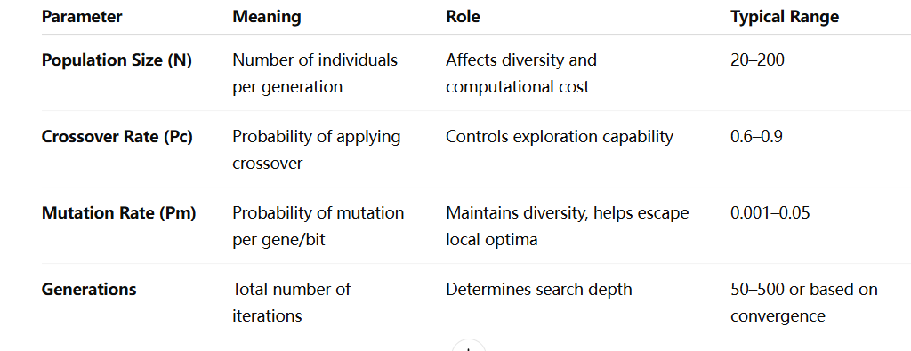
​​Parameter Setting and Tuning
Parameters are not arbitrary, they directly affect the convergence speed of the algorithm, the quality of the solution, and even whether the search fails.
Key Parameters and Their Roles:

Slide 35
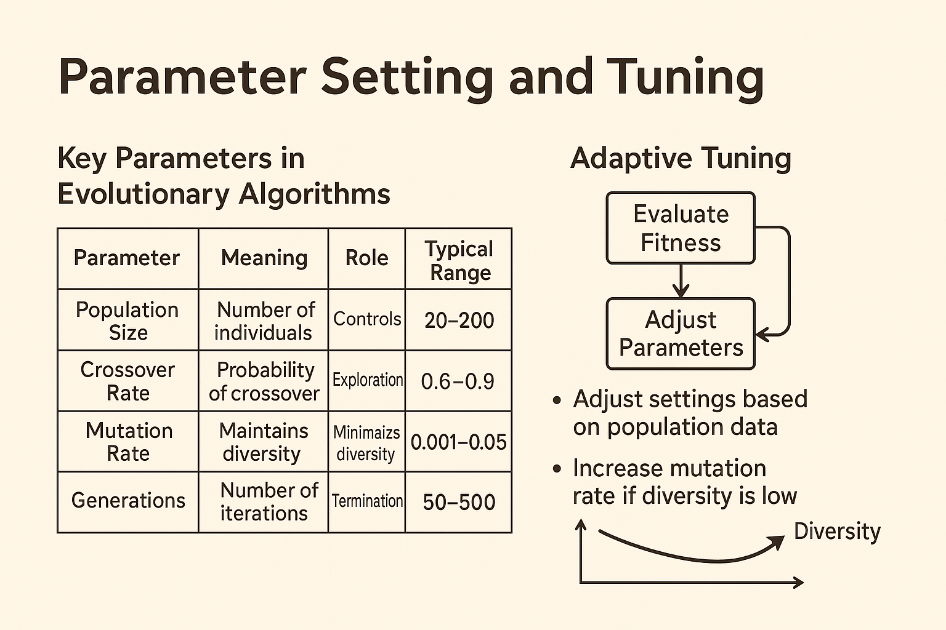
​​Parameter Setting and Tuning
Parameter Adjustment Strategies
Static Setting
Parameters remain fixed during evolution
Easy to implement, but lacks flexibility
Dynamic Adjustment
Parameters change over time (e.g., decrease mutation rate)
Examples:
- Mutation rate drops from 0.05 → 0.005 as individuals converge
- Crossover rate increases from 0.6 → 0.95 to promote early exploration
Adaptive Tuning (Feedback-based)
Parameters respond to population state automatically
-If diversity is low → increase mutation rate
- If fitness stagnates → increase crossover activity
Often uses feedback loops or hybrid local search mechanisms

Slide 36
​​Parameter Setting and Tuning
Summary Quote:
"Parameters are the steering wheel of evolutionary algorithms. Tune them right, and the algorithm flies; tune them wrong, and it crashes."

Slide 37
Elitism Important
Analogy:
Imagine a "survival competition" where the top performers are guaranteed to pass into the next generation, even without reproducing, to ensure the best traits aren’t accidentally lost.
Definition:
Elitism is a strategy in evolutionary algorithms where the top-performing individuals from the current generation are directly preserved in the next generation without undergoing selection, crossover, or mutation.

Slide 38
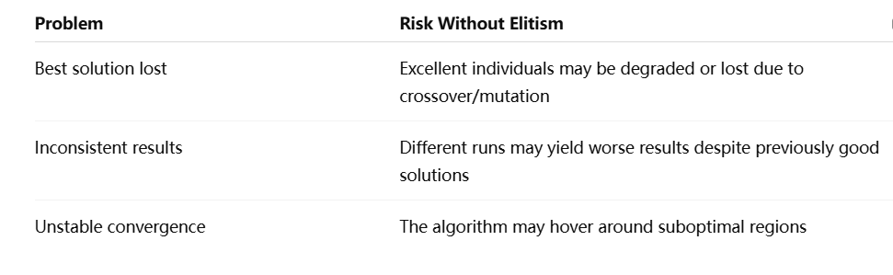
Elitism Important
Why Is Elitism Important?
Goal of Elitism:
Stabilize performance, preserve global optima, and accelerate convergence.

Slide 39
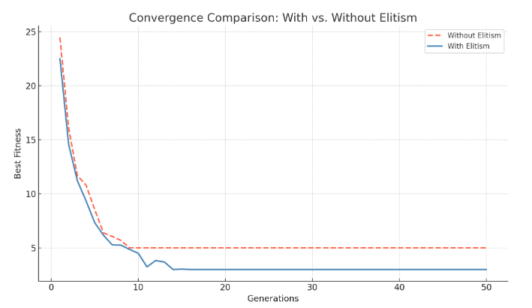
Elitism Important
Why Is Elitism Important?
With Elitism: The convergence speed is faster, and the optimal solution is continuously retained and gradually improved
Without Elitism: Convergence is slow and stagnant after a certain algebra, and it may fall into a local optimal or lose a good solution
The above diagram shows the comparison of the convergence process between the elite strategy (blue line) and the non-elite strategy (red line):

Slide 40
Elitism Important
Why Is Elitism Important?
Summary Quote
Elitism is like an insurance policy for evolution—ensuring the best aren’t eliminated by chance. But if there are too many elites, innovation dies.

Slide 41
YOUR LOGO
03
Typical Applications of Evolutionary Computation

Slide 42
Typical Applications of Evolutionary Computation
Why Evolutionary Algorithms for Real-World Problems?
the limitations of traditional optimization methods:
Gradient-based methods fail on non-differentiable, discontinuous problems
Exhaustive search is computationally prohibitive
Dynamic, noisy, multi-objective problems are hard to model explicitly
Evolutionary algorithms are general-purpose black-box optimizers. If you can evaluate performance, you can optimize — no gradients, no assumptions.

Slide 43
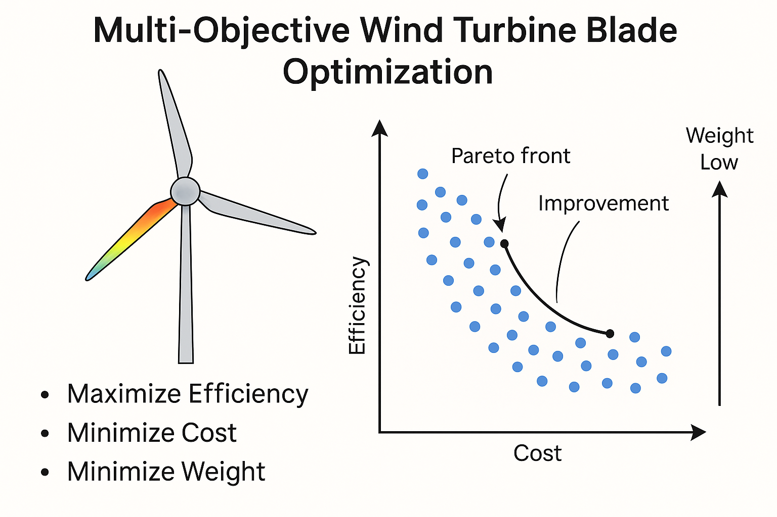
Typical Applications of Evolutionary Computation
Four Major Application Domains
✅ 1) Engineering Optimization
EAs are powerful for design optimization and resource scheduling.
Examples:
Structural optimization (e.g., truss design, material layout)
Circuit layout, antenna design
Path planning: robot navigation, drone routing
(Multi objective optimization of vertical axis wind turbine blade structure based on genetic algorithm)

Slide 44
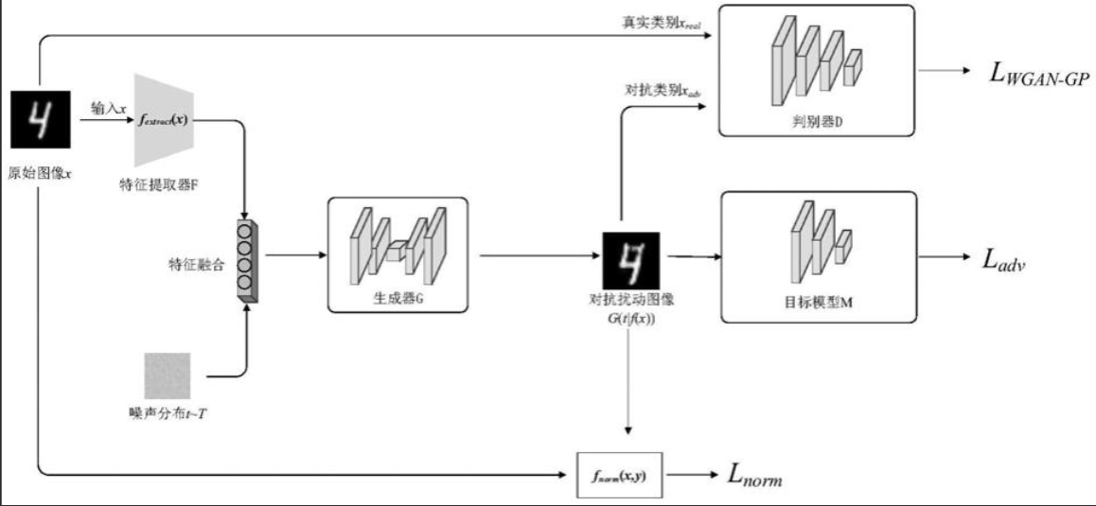
Typical Applications of Evolutionary Computation
Four Major Application Domains
✅ 2) Intelligent Systems and Control
Used for parameter tuning, control logic design, and reinforcement learning.
Examples:
GA for tuning PID controller parameters
GP (Genetic Programming) for evolving control strategies
Evolutionary robotics & game strategy evolution
EAs are model-free and handle nonlinear, noisy systems robustly — ideal for complex control tasks.

Slide 45
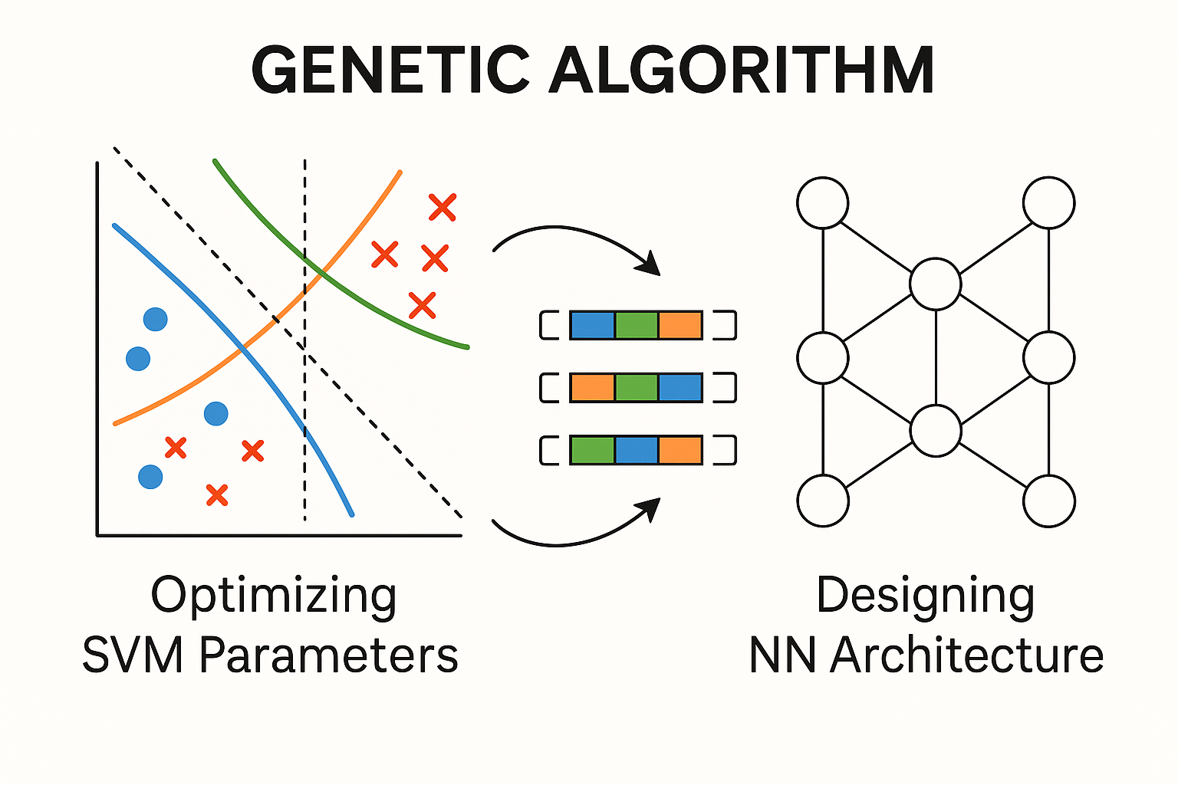
Typical Applications of Evolutionary Computation
Four Major Application Domains
✅ 3) Data Science & Machine Learning
EAs can be hybridized with AI, deep learning, and AutoML.
Examples:
Feature selection: use GA to pick optimal feature subsets
Hyperparameter tuning: evolve learning rates, layer sizes, kernel types
Neuroevolution: evolve neural network architectures and weights (e.g., NEAT)
GA optimizing SVM parameters and NN architecture

Slide 46
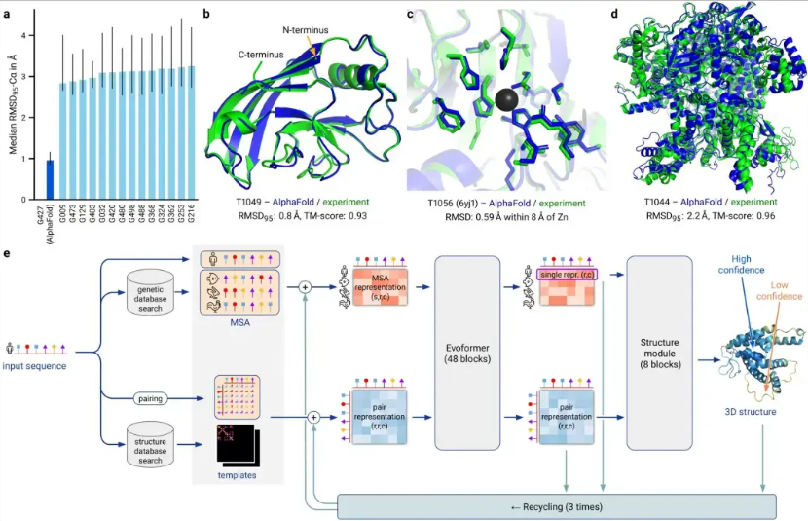
Typical Applications of Evolutionary Computation
Four Major Application Domains
✅ 4) Computational Biology & Life Sciences
From nature to nature — EAs solve complex biological problems.
Examples:
Protein structure prediction
Gene expression analysis & biomarker selection
Co-evolution models in ecological simulations
(Protein structure prediction)

Slide 47
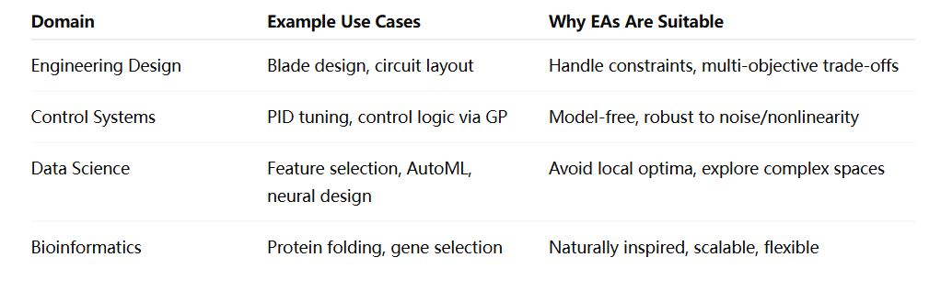
Typical Applications of Evolutionary Computation
Summary Table of Application Domains
"Where rules are unknown and objectives compete, evolution finds a way."
— Evolutionary computation thrives in unstructured, noisy, and complex worlds.

Slide 48
THANK YOU

